Slide 1
Twitter US Elections 2016
Analyzing Pro-Democrat, Pro-Republican and Swing States through Sentiments of Tweets in 2016 US Presidential Elections

Slide 2
Research Problem
Based on the sentiments of tweets on the day of the 2016 US Presidential Elections, which states supported the Democrats? supported the Republicans? were the Swing States?
Were the results of the research reflected to the official results of the election?

Slide 3
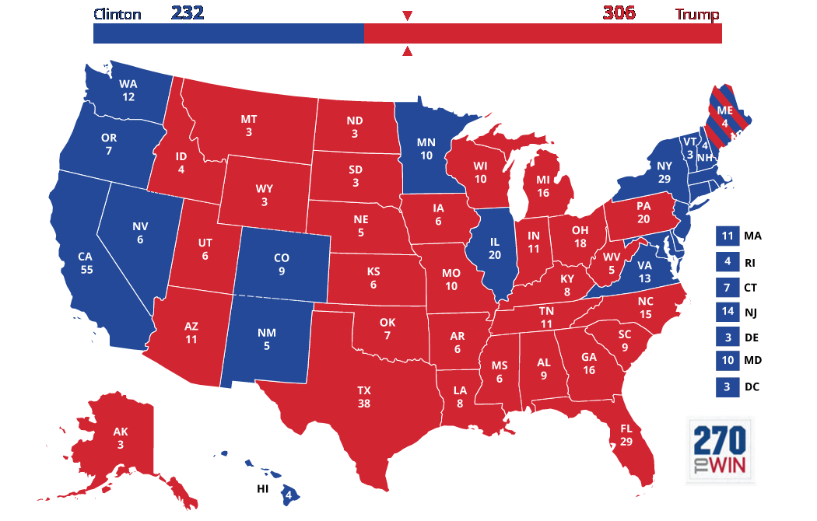

Slide 4
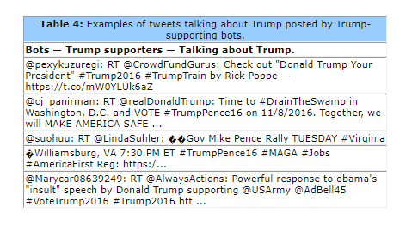
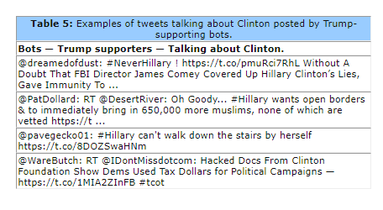
Review of Related Literatures
Bessi, Alessandro, and Emilio Ferrara. "Social bots distort the 2016 US Presidential election online discussion." (2016).

Slide 5
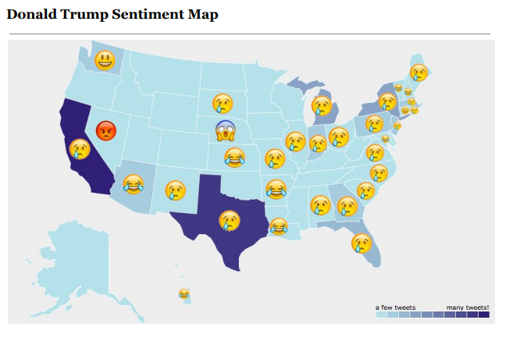
Review of Related Literatures
Chin, Delenn, Anna Zappone, and Jessica Zhao. "Analyzing Twitter Sentiment of the 2016 Presidential Candidates." (2016).

Slide 6
Methods
Gather all the tweets on November 8, 2016 that are related to the US Election Day.
Tools to be used: Tweepy, Twarc

Slide 7
Methods
Remove bot tweets (if possible)
Tools to be used: Twitter Bot Classifier

Slide 8
Methods
Apply a sentiment analysis through all tweets to determine if the tweet supported the Democrats or the Republicans
Tools to be used: TextBlob (https://github.com/JVogel27/TwitterBotClassifier)

Slide 9
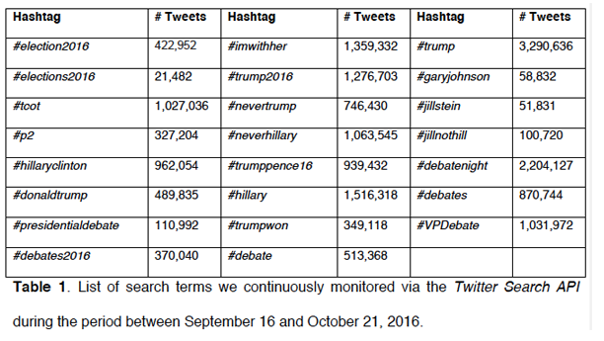
Methods
Apply a sentiment analysis through all tweets to determine if the tweet supported the Democrats or the Republicans
“trump”, “donald trump”, “hillary clinton”, “hillary”, “democrats”, “republicans”
Chin, Delenn, Anna Zappone, and Jessica Zhao. "Analyzing Twitter Sentiment of the 2016 Presidential Candidates." (2016).
Bessi, Alessandro, and Emilio Ferrara. "Social bots distort the 2016 US Presidential election online discussion." (2016).

Slide 10
Methods
Apply a sentiment analysis through all tweets to determine if the tweet supported the Democrats or the Republicans
Tools to be used: TextBlob

Slide 11
Methods
Group all tweets by the state which the Twitter User lives
Methods to be used: MapReduce

Slide 12
Methods
Calculate the percentage of Pro-Democrat and Pro-Rebublican tweets of each state (for Swing States: determine if they are statistically tied)
Determine if the state was Pro-Democrat and Pro-Rebublican (for Swing States: determine if they are statistically tied)
Methods to be used: MapReduce

Slide 13
Methods
Compare the results to the official 2016 US Election Results

Slide 14
Methods
Tweet | Location / State
Trump for the win #MakeAmericaGreatAgain | FL
Sentiment Analyzer (TextBlob)
Rooted for
Republicans

Slide 15
Tweet | Location / State | Rooted for
Trump for the win #MakeAmericaGreatAgain | FL | Republicans
Tweet | Location / State | Rooted for
Trump for the win #MakeAmericaGreatAgain | FL | Republicans
Tweet | Location / State | Rooted for
Hillary is the pres! :o | FL | Republicans
Tweet | Location / State | Rooted for
Trump for the win #MakeAmericaGreatAgain | FL | Republicans
Tweet | Location / State | Rooted for
Hillary is the pres! :o | FL | Republicans
Tweet | Location / State | Rooted for
Hillary is the pres! :o | FL | Republicans
MapReduce
Location / State | Democrats | Republicans
FL | 32434 | 60954
Location / State | Democrats | Republicans
FL | 32434 | 60954
Location / State | Democrats | Republicans
FL | 32434 | 60954

Slide 16
Dataset
https://github.com/chrisalbon/election_day_2016_twitter/
Tweets related to 2016 US Elections
7 Million Tweets in total

Slide 17
Sources
Alessia, D., Fernando Ferri, Patrizia Grifoni, and Tiziana Guzzo. "Approaches, tools and applications for sentiment analysis implementation." International Journal of Computer Applications 125, no. 3 (2015).
Bessi, Alessandro, and Emilio Ferrara. "Social bots distort the 2016 US Presidential election online discussion." (2016).
Chin, Delenn, Anna Zappone, and Jessica Zhao. "Analyzing Twitter Sentiment of the 2016 Presidential Candidates." (2016).

